Slide 1

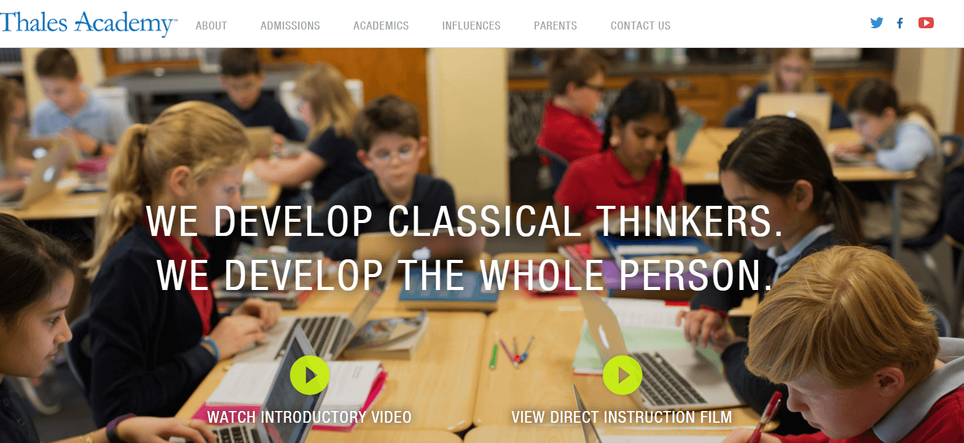
Thales Academy Web Design
The Challenge
Thales Academy, a system of independent schools based in North Carolina, came to Affirma wanting to improve their website effectiveness in student conversion. The school system provides excellent and affordable education to students in Pre-K to 12th grades through Direct Instruction and a classical curriculum. Thales stakeholders felt the creation of a true marketing website could provide more clarity and impact on parents deciding what school to send their children. Through the design and deployment of a new website they hoped to capture the school spirit, engage parents with inspiring content, as well as motivate parents to schedule a campus visit.
Affirma’s Creative team worked with the Thales team to map out the expected flow of users. It was very important that users of the website could search and navigate effectively and intuitively. Developed responsive wireframes from requirements and the information architecture outputs so users could utilize the site from mobile and tablet devices. Created a modern minimalistic design while maintaining the Thales culture, voice and aesthetic. Design iterations were focused on ease of use, streamlined navigation and visual quality. We utilized modern technology such as sticky headers, animations and parallax scrolling to engage users as they explored the site. Affirma provided a one stop agency for both design and development expertise.
What We Did
Results
Thales Academy redesigned website encapsulated Thales vision of classical education blended with modern technology. Every aspect of the site, from its attractive and streamlined design, to its intuitive navigation, guided prospective students and families to conversion. The development language and structure also made future content editing simple and achievable.

